Slide 1
Lab 4
System Call
TA: Yung-Tung Chou
Professor：Hsung-Pin Chang
Operating System Lab
2021/09/30

Slide 2
Outline
Introduction
Example – compile and install Linux Kernel from source code
Exercises
References

Slide 3
The definition of system calls (1/3)
System calls provide the interface between a process and an operation system.
Application program to request service from the operating system

Slide 4
The definition of system calls (2/3)
All modern systems offers a series of privilege levels.
The operating system executes at the highest level of privilege
Allows the applications to request services via system calls, which are often implemented through traps.

Slide 5
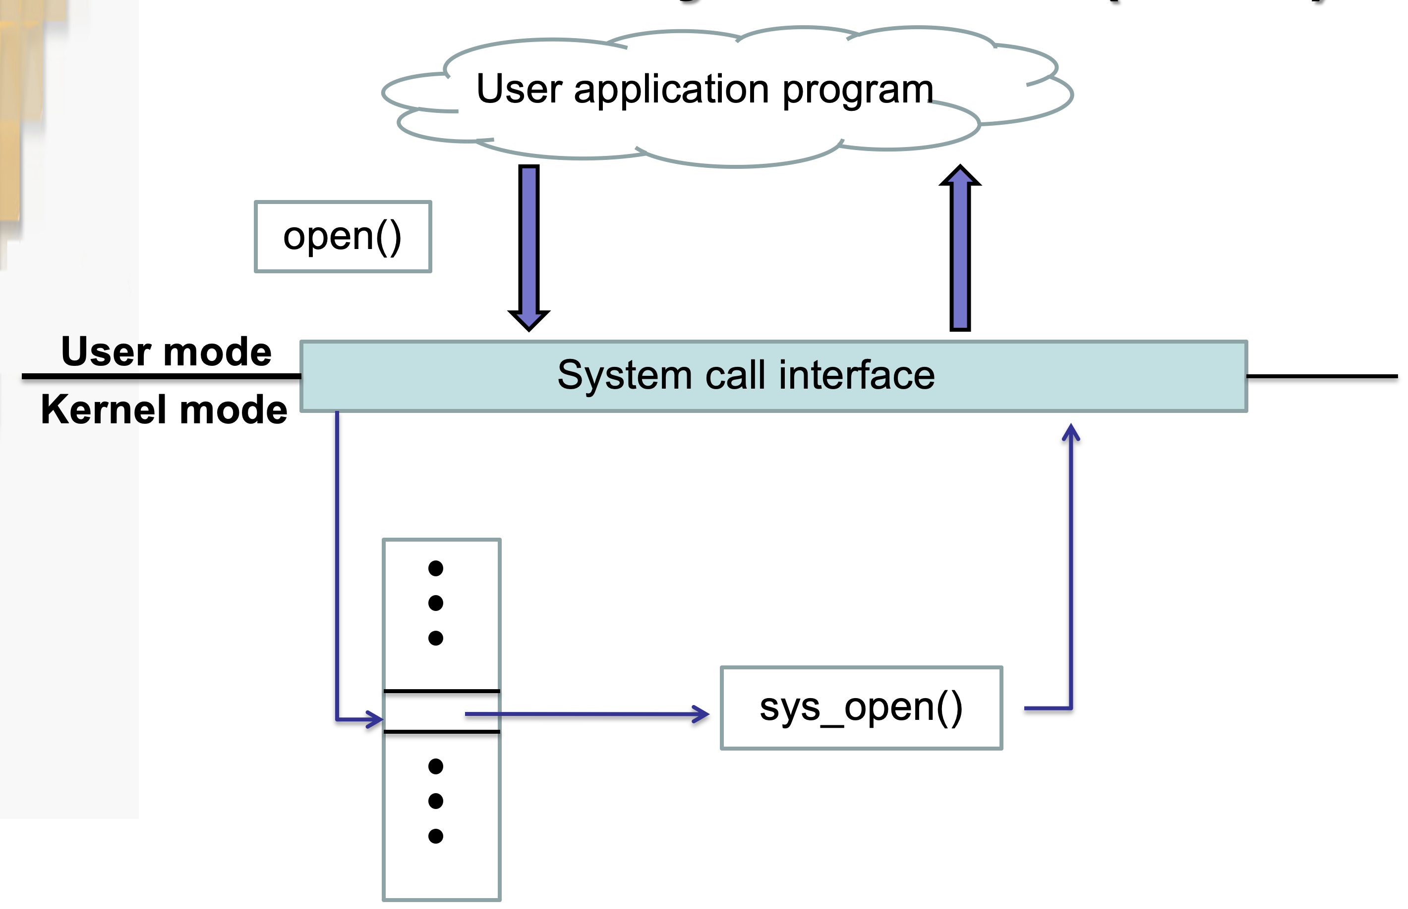
The definition of system calls (3/3)

Slide 6
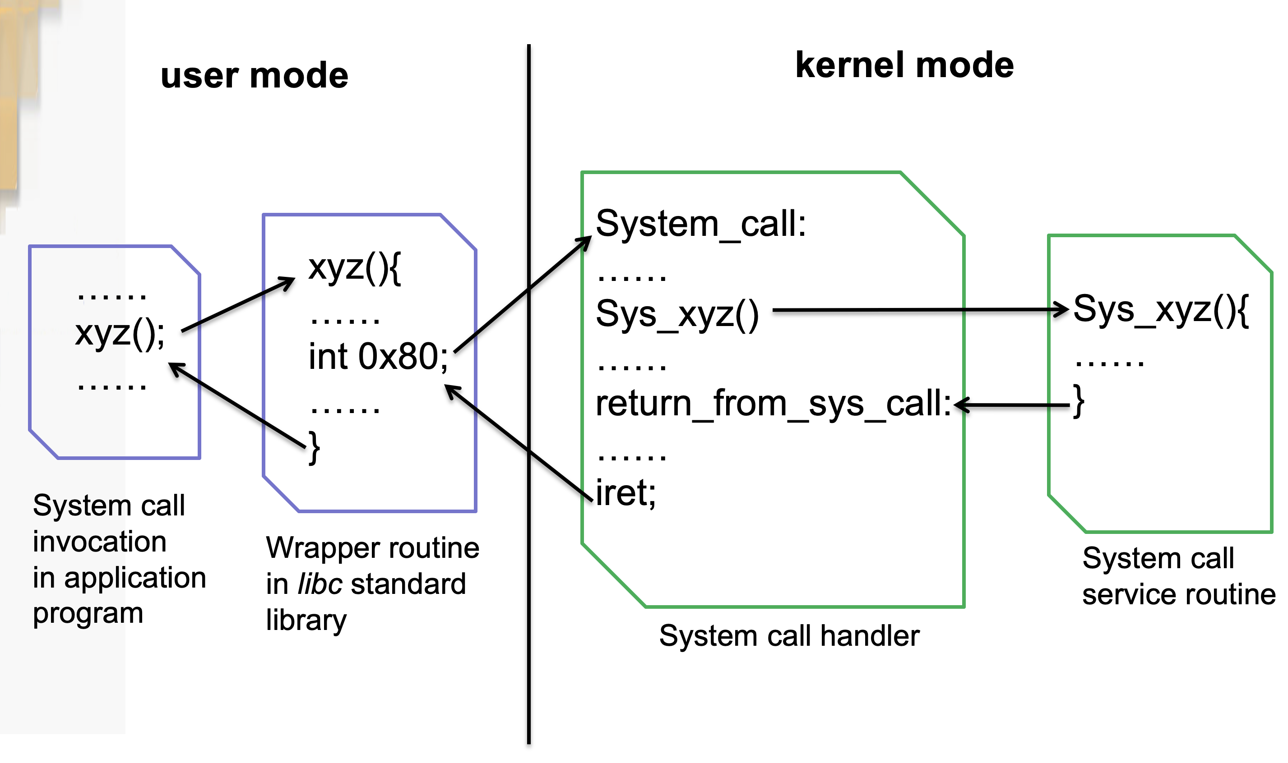
An example of system calls

Slide 7
Typical implementations of system calls
System calls can be roughly grouped into five major categories:
Process control
File management
Device management
Information maintenance
Communication

Slide 8
Example –add a system call and compile Linux Kernel from source code

Slide 9
A Step-by-Step Tutorial
Install all needed packages for making the kernel
Add a new system call (Kernel will change if we add a new system call)
Make kernel and install our new kernel
Test the new system call

Slide 10
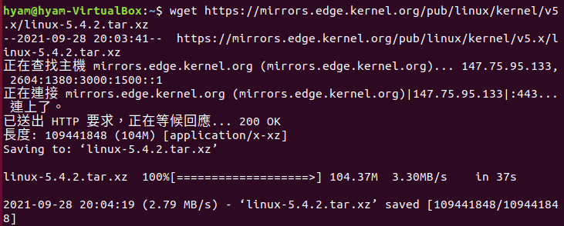
Step.1 Get the Linux kernel source code
Download linux kernal
Code: wget https://mirrors.edge.kernel.org/pub/linux/kernel/v5.x/linux-5.4.2.tar.xz

Slide 11

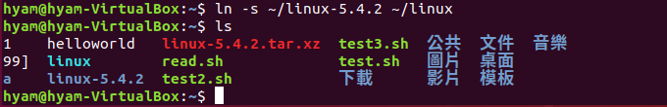
Extract tar.xz File
extract the source code
Code: tar -xvf linux-5.4.2.tar.xz -C ~/
Linux-5.4.2 will be in your home directory, to make the later process easier, we can create a soft link to the directory.
Code: ln -s ~/linux-5.4.2 ~/linux

Slide 12
Install the Compile Tools
sudo apt-get install git
sudo apt-get install ccache
sudo apt-get install libssl-dev
sudo apt-get install fakeroot
sudo apt-get install bison
sudo apt-get install gcc
sudo apt-get install flex
sudo apt-get install make

Slide 13
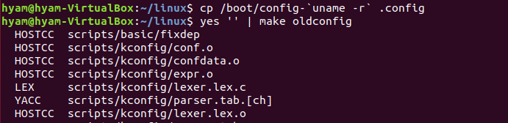
Transfer the Current Kernel Configuration
Clean all the previous configurations of the kernel source code
Code: cd linux
Code: make mrproper
we can transfer our current kernel configuration to the new kernel.
Code: cp /boot/config-`uname -r` .config
Code: yes '' | make oldconfig

Slide 14
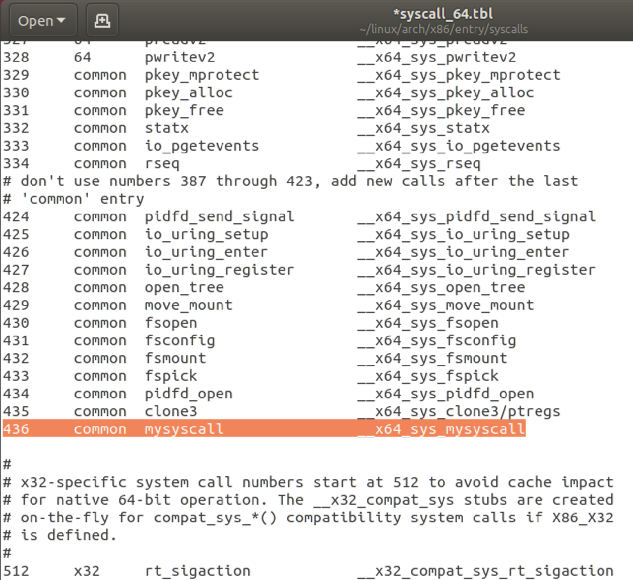
Add Customized System Call (1/3)
Add the System Call Number
Code : gedit ~/linux/arch/x86/entry/syscalls/syscall_64.tbl
Add the following code
Remember Line 436

Slide 15
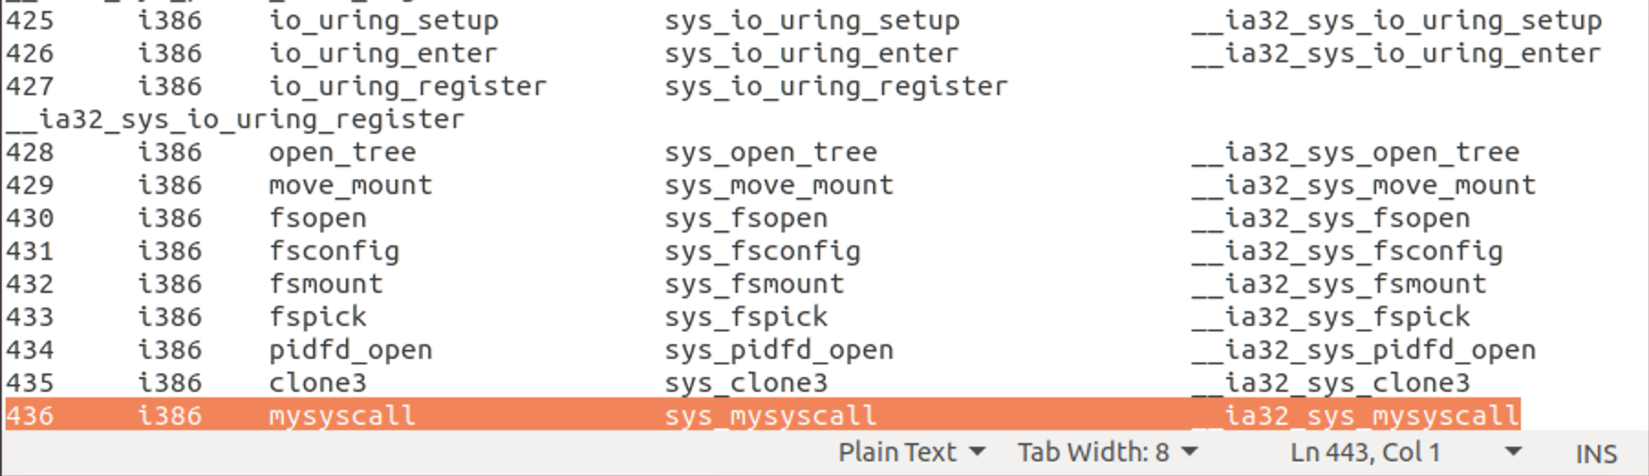
Add Customized System Call (2/3)
Also add it to the file syscall_32.tbl
Code: gedit ~/linux/arch/x86/entry/syscalls/syscall_32.tbl
Add the following code

Slide 16
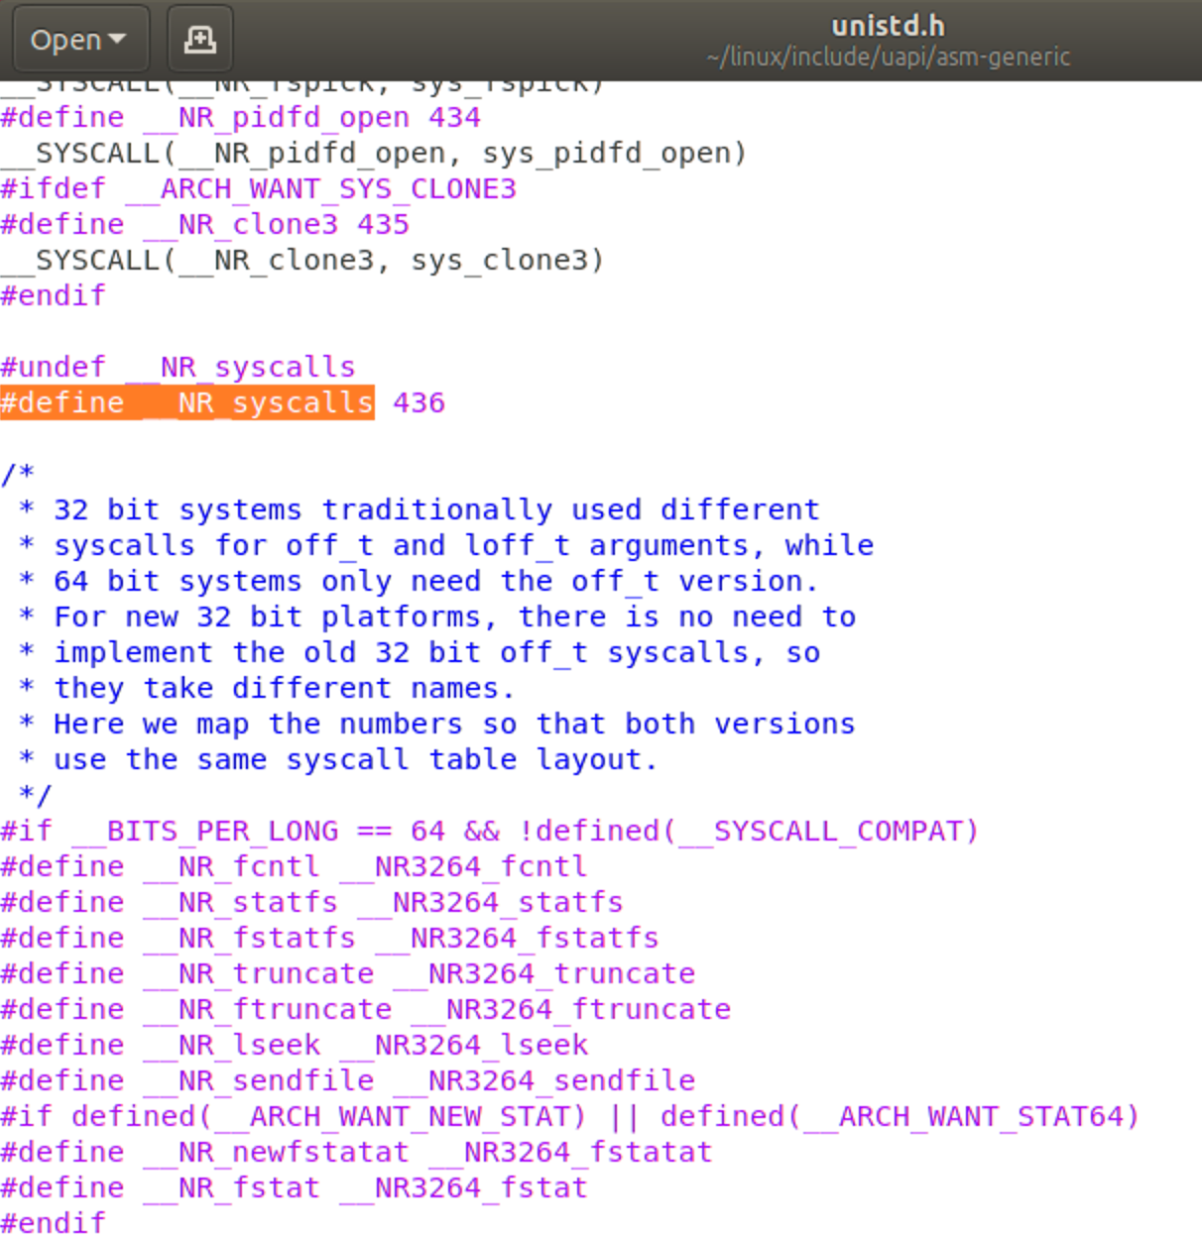
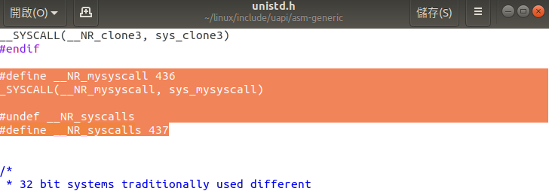
Add Customized System Call (3/3)
Add it to the unistd.h file as a micro
Code: sudo gedit ~/linux/include/uapi/asm-generic/unistd.h
Add the following code

Slide 17
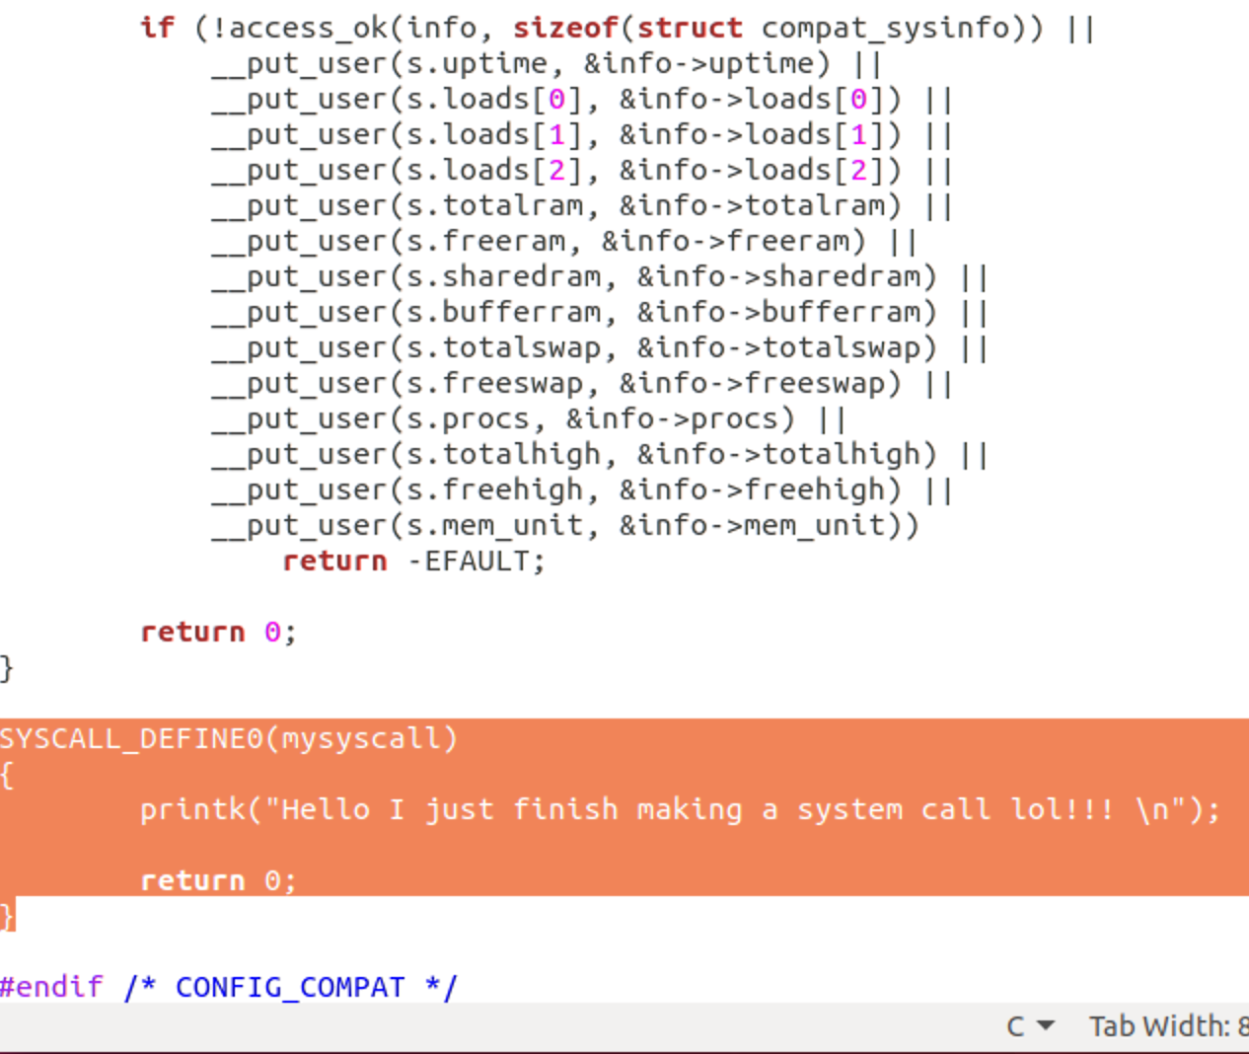
Implement the System Call Function (1/3)
Code: gedit ~/linux/kernel/sys.c
Append the following Syscall function to the end of the file.

Slide 18
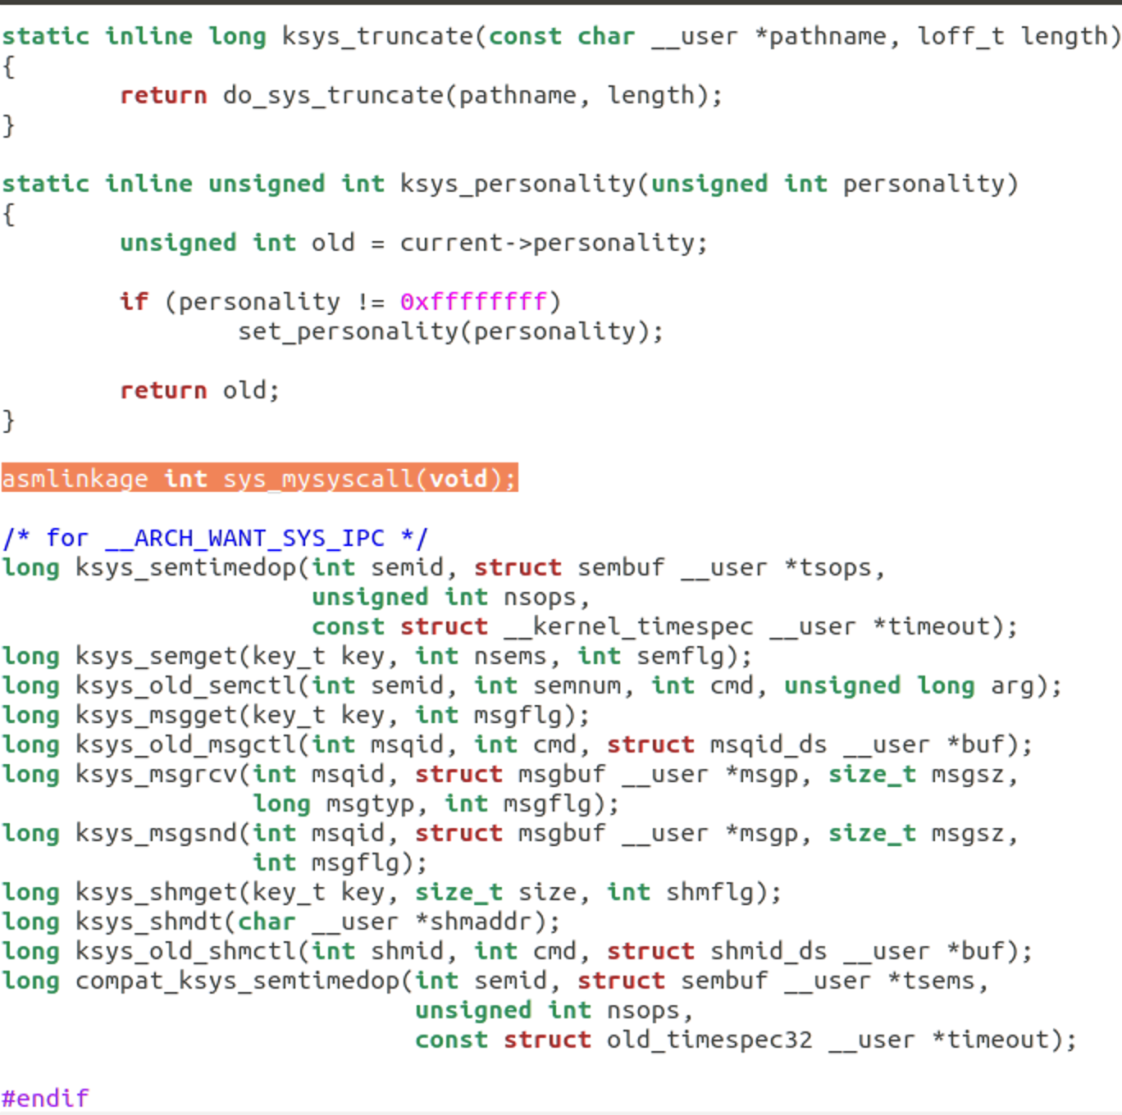
Implement the System Call Function (2/3)
Don’t forget the declaration
Code: gedit ~/linux/include/linux/syscalls.h
Add the line at almost the end of the file.
Code: asmlinkage int sys_mysyscall(void);

Slide 19
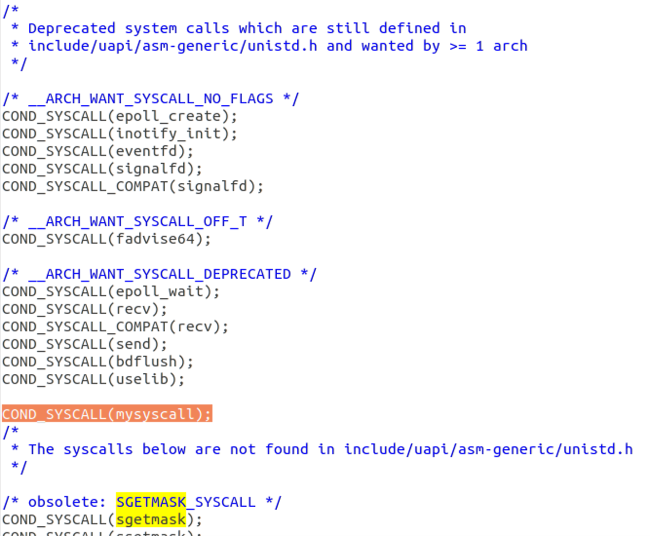
Implement the System Call Function (3/3)
For compatibility add the following code
Code: gedit kernel/sys_ni.c
Add the code
Code: COND_SYSCALL(mysyscall);

Slide 20
Congratulation! You have add a system call~

Slide 21
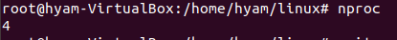
Compile a Linux Kernel (1/2)
Get thread or cpu core count using nproc command 指令: nproc
切換到root: su
更改root密碼: sudo passwd root

Slide 22
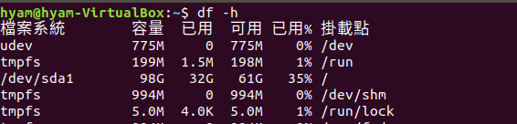
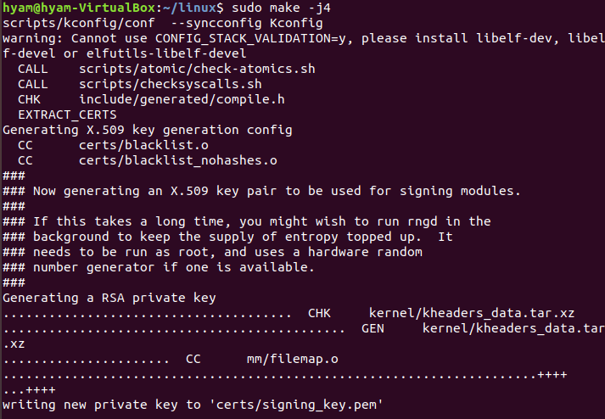
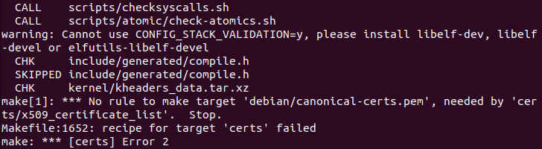
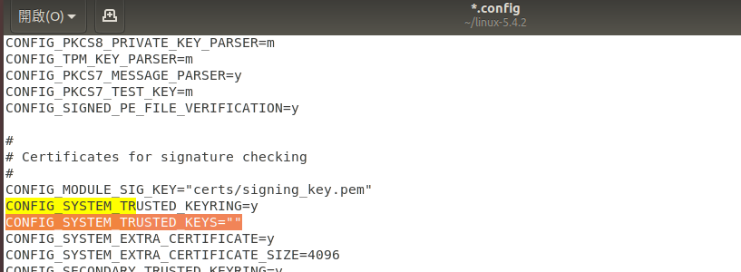
Compile the Kernel (2/2)
Code: sudo make -j4

Slide 23
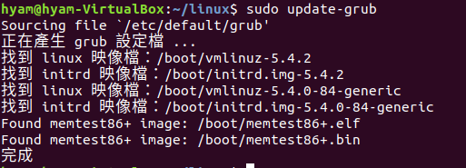

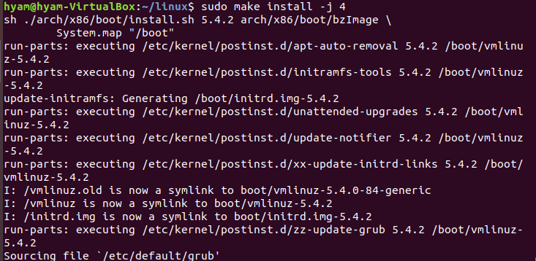
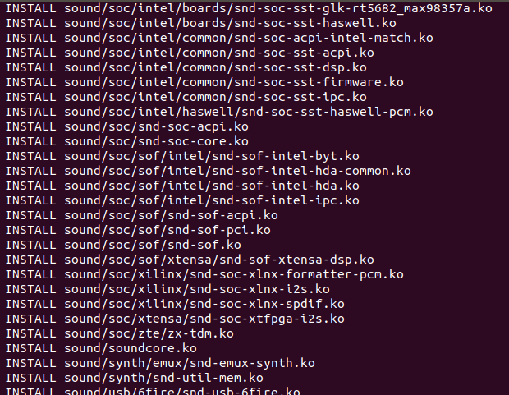
Install the Kernel
Code: sudo make modules_install -j 4
Code: sudo make install -j 4
Code: sudo update-grub

Slide 24
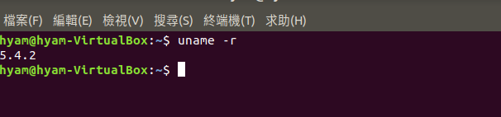
Verify
Reboot the system and check for kernel version
Code: sudo reboot
Check for kernel version code：uname -r

Slide 25
Congratulation! Linux Compile Kernel version 5.4.2
You completed various steps to build the Linux kernel from source code and compiled kernel should be running on your system

Slide 26

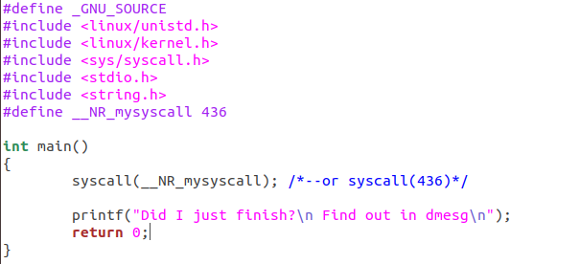
Test system call (1/2)
Create a test.c file code：gedit test.c
Type the following code

Slide 27
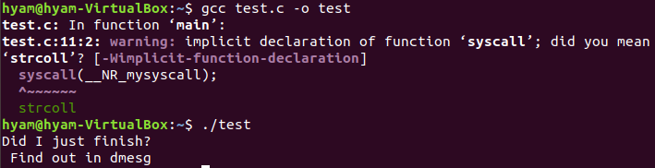
Test system call (2/2)
Compile test.c code：gcc test.c -o test
Run code：./test

Slide 28
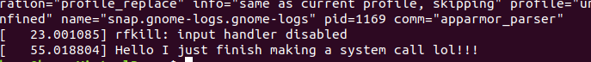
Kernel message
Use dmesg to check for kernel message code：dmesg | tail
Kernel successfully printk Hello I just finish making a system call lol!

Slide 29
Successfully finished using the New system call

Slide 30
Exercises
Basic: add a system call [75 pt] 8-20
Bonus 1: making kernel[+10 pt] 21-25
Bonus 2: using the newly created system call [+ 5 pt] 26-29

Slide 31
References
operating-system-concepts-10th
System call
Add a system call in linux

Slide 32
The End

